Slide 1


Introduction
ACCESSDATA® FORENSICS
Windows 2K/XP Registry
Forensic Analysis
Incident Response
eDiscovery
Information Assurance

Slide 2
Module Objectives
2K + XP Registry “Files”
SIDs in NTFS
Notable Tracking Differences

Slide 3
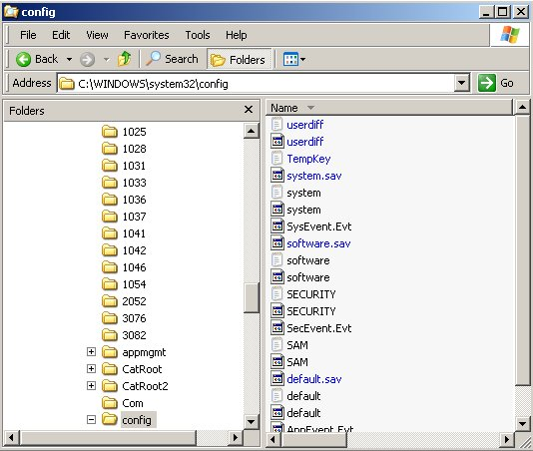
2K + XP Registry Files
SAM
SYSTEM
SECURITY
SOFTWARE
And don’t forget each user’s → NTUSER.DAT
2K vs. XP ?

Slide 4

2K + XP Registry Files
SAM
  HKLM \ SAM
  Account information for
  users and groups on the system
  Logon password Hash

Slide 5

2K + XP Registry Files
SYSTEM
  HKLM \ SYSTEM
  Device drivers
  Computer name
  Active time bias

Slide 6

2K + XP Registry Files
SECURITY
  HKLM \ SECURITY
  Local security policy, user rights, groups

Slide 7

2K + XP Registry Files
SOFTWARE
  HKLM \ SOFTWARE
  Program settings
  Current version settings

Slide 8

2K + XP Registry Files
NTUSER
  HKU \ SID
  User preferences
  Desktop layout
  Wallpaper \ Screen savers
  Etc …

Slide 9
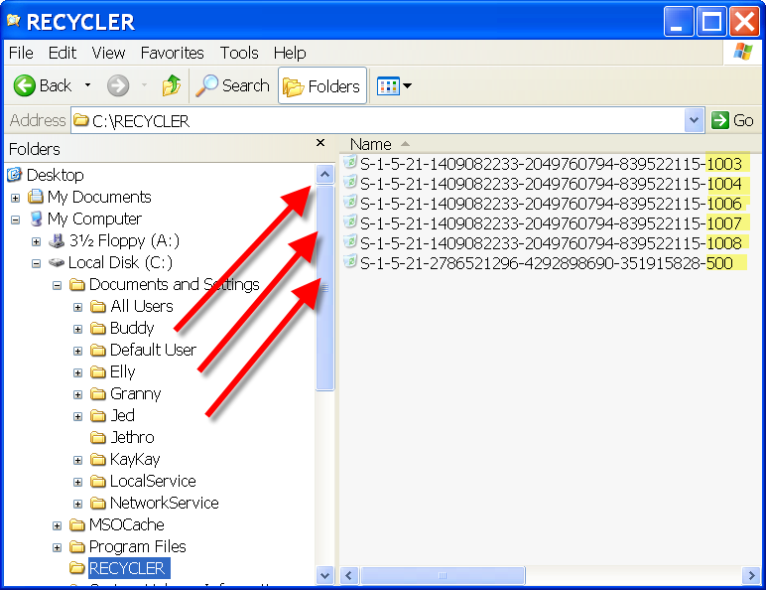
Multiple Profile Issues
Each user also has something new in this environment:
A “SID” or
Security ID

Slide 10
Multiple Profile Issues
Concerns could be:
  Resolving usernames to SID folders (Recycle Bin and Access Control)
  Processing SAM user information (Last logon times, for example)
  System volume information

Slide 11
Notable Tracking Differences
MRU Information:
  Tracking:
    Open / Run / Save lists
    Printers / Find Files / Find Computers
    Individual file types (greater numbers)
Mounted Devices:
  Indication of recently mounted and assigned
  devices and drive letters – may be a clue

Slide 12
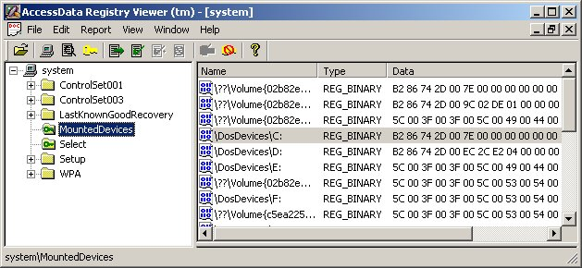
Notable Tracking Differences
Check the SYSTEM file
→ Mounted Devices

Slide 13
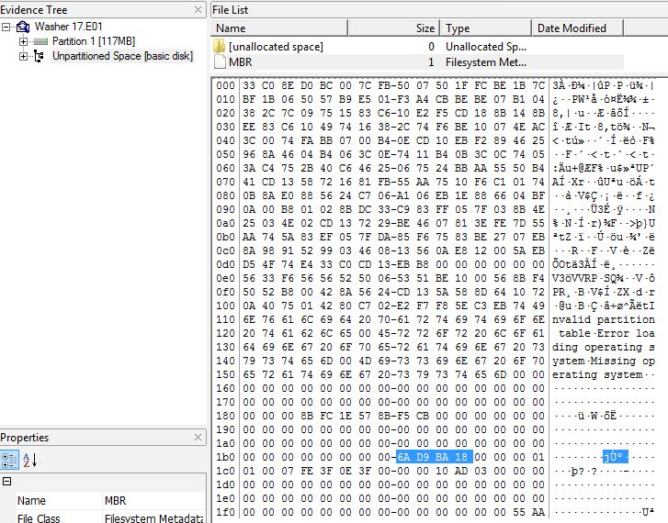
Notable Tracking Differences

Slide 14
Module Review
2K + XP Registry “Files”
SIDs in NTFS
Notable Tracking Differences

Slide 15



